Slide 1
SEN152 – Topic 1: The history of Software Engineering
1.1 The software engineering journey
1.2 The software process
1.3 Software development principles

Slide 2
Module Outcomes
Demonstrate insight in the history of software development.
Demonstrate an understanding of different options for software development life cycles related to software design and development, and key terms, facts, principles and rules of software development.
Apply methods, tools and modelling techniques commonly employed during the various phases of software development.
Demonstrate an understanding of the importance of software maintenance and documentation.
Identify modern software development and management platforms, tools, and services, and outline the nature of the support provided.
Demonstrate an understanding of the notion of quality in software and how a Quality Management System can provide the required organisational framework.

Slide 3
(1) Introduction
In this topic, you will gain knowledge in the following areas:
1.1 The software engineering journey.
1.2 The software engineering process.
1.3 Software development principles.

Slide 4
(1.1) The software engineering journey
1940s – 1960s
The era of early computers, such as ENIAC (Electronic Numerical Integrator and Computer) and UNIVAC (Universal Automatic Computer), is where the roots of software engineering can be found (Khan, 2023).

Slide 5

(1.1) The software engineering journey
Figure 1 – Photograph of World’s First Computer, the Electronic Numerical Integrator and Calculator (National Archives, 2025)

Slide 6
(1.1) The software engineering journey
1960s – 1990s
Margaret Hamilton, an MIT computer scientist, invented the term ‘software engineering’.
During the 1970s, software engineering methodologies emerged.
Waterfall model became popular
Iterative and incremental development started to take shape in the 1980s
RAD and OOP
(Khan, 2023)

Slide 7

(1.1) The software engineering journey
1990s – present
The internet and personal computing took form and software applications expanded.
Agile methods gained a lot of attention during this time.
Open-source development was a growing field.
Business focus was on collaboration and process automation.
(Khan, 2023)

Slide 8
(1.1) The software engineering journey
Computer programming languages – a timeline
Only shown from 2000 on the slides (HP Tech Takes, 2018):
2000: Microsoft created C# (similarities to Java) as a mixture of Visual Basic and C++.
2003: Martin Odersky developed the programming language, Scala.
2003: Groovy (as a result of Java) was created by Bob McWhirter and James Strachan
2009: Go was developed by Google to solve problems with large systems.
2014: Apple created Swift to replace Objective-C, C, and C++.
Today: Many older programming languages are still used today, and many are used as a foundation for the creation of new or more advanced languages. The aim is to reduce the workload on programmers and to simplify software creation.

Slide 9

(1.1) The software engineering journey
Read: https://developer.apple.com/swift/ | Article duration: 05:00 (estimated)
Discussion:
Conduct brief research on Apple’s Swift language. Discuss the safety of Swift with your lecturer and fellow students.

Slide 10

(1.1) The software engineering journey
Integrated Development Environments (IDEs)
Tools used by software developers to streamline their design and programming experience
An IDE has an integrated user interface which allows developers to easily create, update and debug code.
(Okeke, 2022)

Slide 11
(1.1) The software engineering journey
IDEs benefits
IDEs support the development cycle and streamlines the process.
IDEs check for errors automatically and this improves code quality.
Developers can complete code much faster with the capabilities of IDEs.
An IDE provides a centralised space for developers. Version control and debugging tools help developers manage their work more efficiently.
Developers can quickly and efficiently update and rename code.
(Okeke, 2022)

Slide 12
(1.1) The software engineering journey
Read: https://www.techrepublic.com/article/best-ide-software/ | Article duration: 05:00 (estimated)
Discussion:
Discuss the classifications of IDEs with your lecturer and fellow students.

Slide 13
(1.2) The software engineering process
Software engineering in the organisation
Software Engineering is defined as the “systematic application of scientific and technological knowledge, methods, and experience to the design, implementation, testing, and documentation of software” (Letaw, 2024).
Organisations that do not possess the required IT functions to support systems development, will outsource the systems development project to a third-party IT company.
There is no one set of global methodologies or techniques which could be adopted for software development as software systems come in various sizes and types (Sommerville, 2009).

Slide 14
(1.2) The software engineering process
Software engineering in the organisation
Sommerville (2011) states that “a professionally developed software system is often more than a single program. The system usually consists of a number of separate programs and configuration files that are used to set up these programs. It may include system documentation, which describes the structure of the system; user documentation, which explains how to use the system, and websites for users to download recent product information”.

Slide 15
(1.2) The software engineering process
Software engineering participants
Participants from various fields are required to oversee a software project (Lee, 2013).
A software development project today could include systems analysts, project managers, business analysts, system architects, programmers, testers, senior management, end-users, or even outsourced human resources.
The term ‘stakeholder’ requires the project manager to include all who are directly and indirectly affected by the new software development project.
Higher management might be more concerned with administrative and conceptual skills, as they are responsible to understand the bigger picture and how the software project fits into the business strategy and vision (Letaw, 2024).

Slide 16


(1.2) The software engineering process
Cloud computing and Artificial Intelligence (AI)

Slide 17
(1.2) The software engineering process
Cloud computing and Artificial Intelligence (AI)
Many organisations save costs by moving the responsibility of software operations to cloud providers for a fee.
The concept of buying software services as a utility is not a new phenomenon (Bigelow, 2025).
Cloud computing is critical in households and businesses.

Slide 18
(1.2) The software engineering process
Cloud computing and Artificial Intelligence (AI)
Cloud computing service types include the following (Microsoft, 2025):
Infrastructure as a Service
Platform as a Service (PaaS)
Software as a Service (SaaS)
Serverless

Slide 19
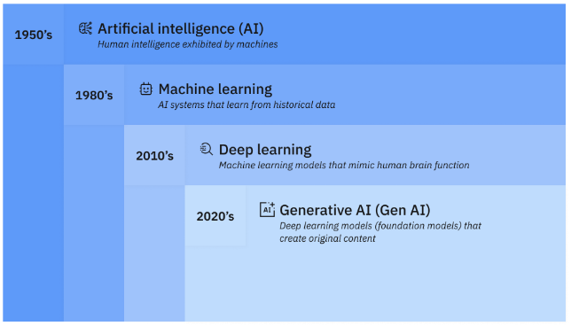
(1.2) The software engineering process
Figure 2 – Relation between AI, ML, deep learning and Gen AI (Stryker & Kavlakoglu, 2024)

Slide 20
(1.3) Software development principles
Principles for developers
Software development in general is fuelling innovation in industries.
Good software should be easy to maintain and usable. (Sommerville, 2011).

Slide 21
(1.3) Software development principles
Principles for developers
Jewel (2023): software development principles that should be practised daily:
DRY (Don’t Repeat Yourself)
KISS (Keep It Simple, Stupid)
YAGNI (You Ain’t Gonna Need It)
SOLID Principles
Single Responsibility Principle (SRP)
Open/Closed Principle (OCP)
Liskov Substitution Principle (LSP)
Interface Segregation Principle (ISP)
Dependency Inversion Principle (DIP)
Continuous Integration and Continuous Deployment (CI/CD)

Slide 22
(1.3) Software development principles
Principles for developers
Gupta (2024):
Architecture first approach
Iterative life cycle process
Component-based approach
Change management system
Round trip engineering
Model-based evolution
Objective quality control
Evolving levels of details
Establish a configurable process
Demonstration-based approach

Slide 23
(1.3) Software development principles
Read the section titled “Real-life examples of companies using principles of software development” https://www.turing.com/blog/principles-of-software-development-guide | Article duration: 08:00 (estimated)
Discussion:
Working in small groups, study any one example principle discussed in the article. Discuss these examples with your lecturer and fellow students.

